Slide 1
Airbnb Data Presentation
By: Alexa Bezzone
November, 2020

Slide 2
Business Question
Could an increase in Airbnb host availability predict an increase in number of Airbnb reviews during the Covid-19 pandemic?

Slide 3
Descriptive Information

Slide 4
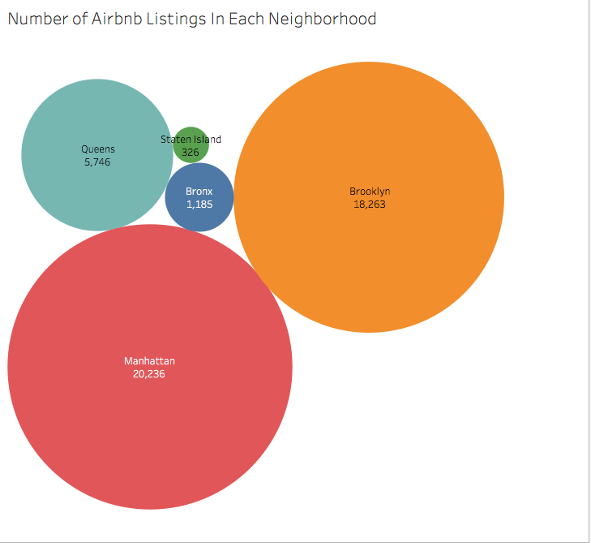
Sample Size
Sample size: 45,757 Airbnb listings
Location: New York City
Neighborhoods: 5
Room Types: 4
Year: September, 2020

Slide 5
Feature & Label Variables

Slide 6
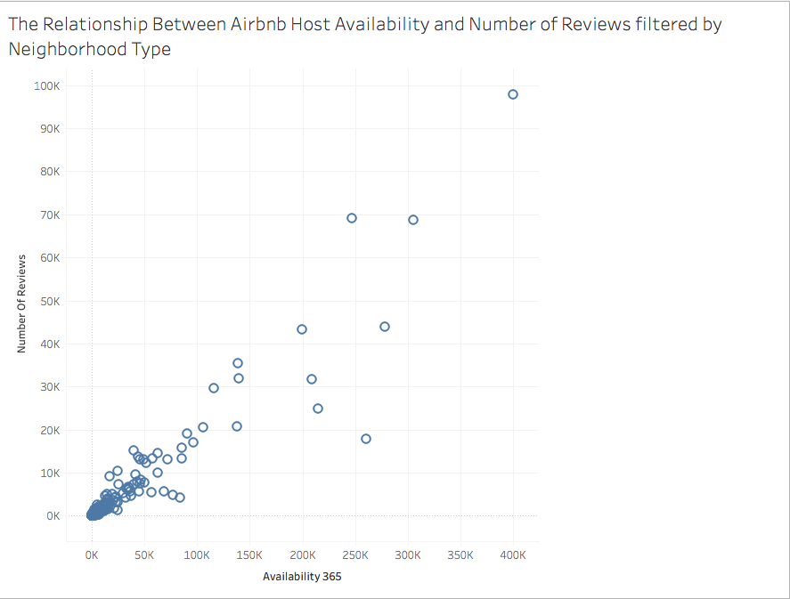
Feature & Label
Features:
Airbnb Host Availability
Neighborhood Type
Label:
Number of Reviews

Slide 7
Model

Slide 8
Linear Regression Supervised Prediction Model
Question:
How can predicting an increase number of reviews through host availability aid the Airbnb Sales and Marketing Team during the Covid-19 pandemic?

Slide 9
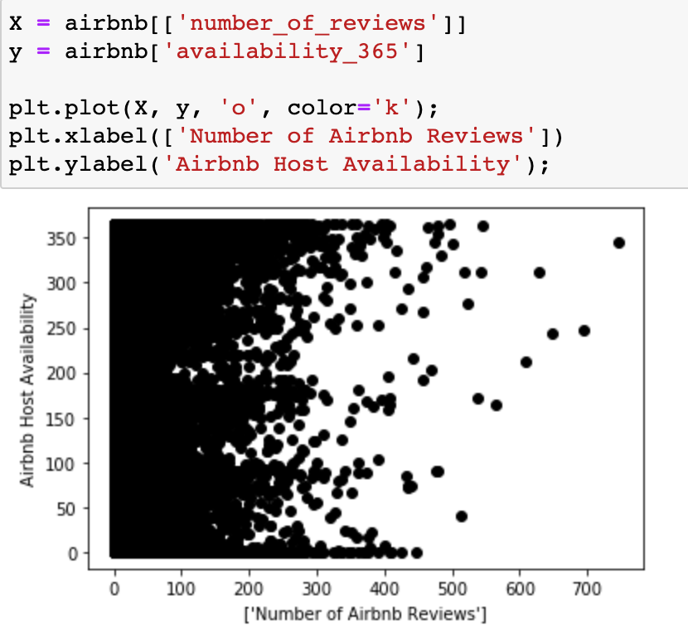
Visualizations: Unsupervised Linear Regression Model

Slide 10
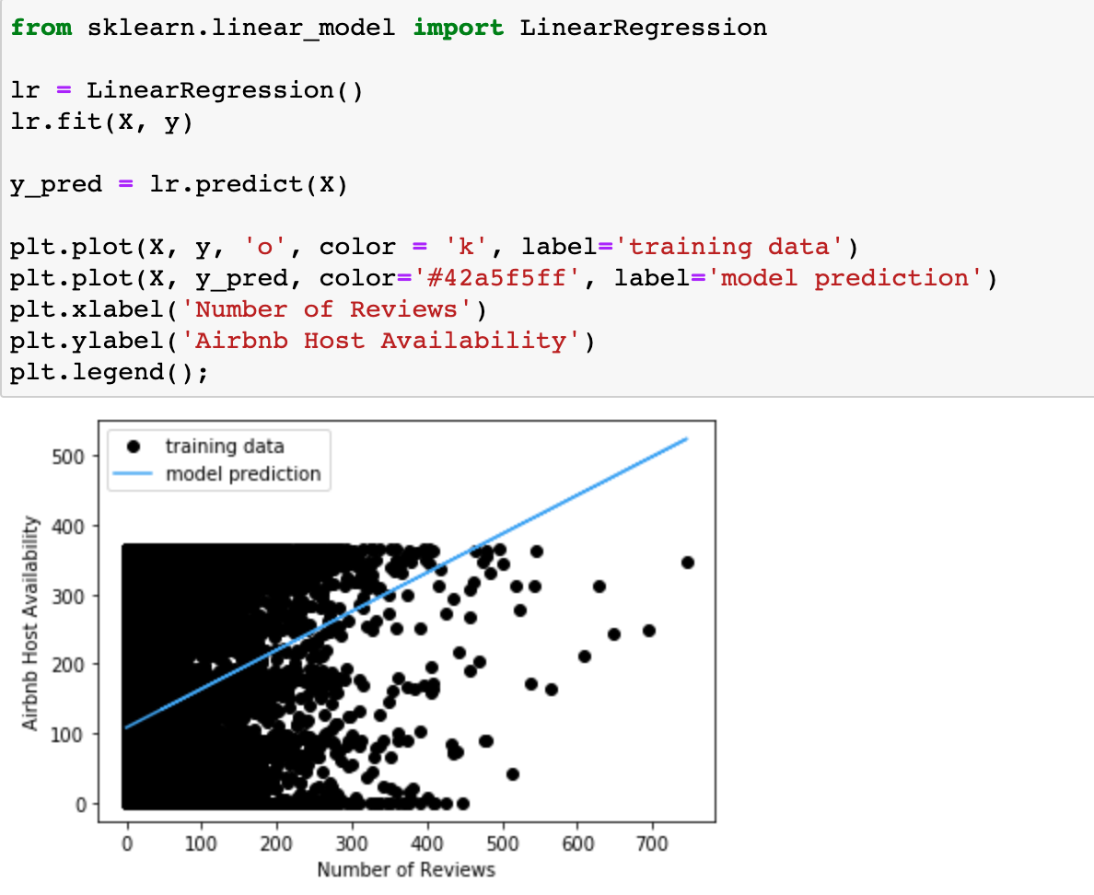
Visualizations: Unsupervised Linear Regression Model Prediction

Slide 11
Results
The model predicts that an increase in Airbnb availability could lead to a potential increase in number of Airbnb reviews a listing receives.
Through this prediction, Airbnb can identify which Airbnb types in the New York region would most likely attract customers based on the high availability and increased number of reviews.
The Airbnb Sales and Marketing team can market the various Airbnb types that have higher availability in hopes the customer will rent out the properties due to the increased number of reviews.

